Slide 1

Learn to Visualize using DAX Tricks in Power BI Pragati Jain
©datavibe

Slide 2











Pragati Jain
Microsoft Data Platform MVP
Superuser at Microsoft Power BI Community
10+ years of industry experience
Manager at Avanade, London
Organizer at DataWeekender conference
Manager at Microsoft Power BI UK User Group
Fun Fact About Me:
I am a painter and proudly call myself ‘TechieArtist’ 😊
©datavibe

Slide 3
Agenda
In today’s session, I will be talking about few of my favourite DAX tricks in Power BI that can help to overcome visualisation limitations.
Dynamic Data points on Line chart Above & Below Average value
Highlight MAX – MIN value on clustered column chart
Display Top N selected bars in the chart
Dynamic Bar colors for Current & Previous Year same Quarter
Conditional Titles on visuals based on slicer selection
Dynamic Color to Card Visual based on slicer selection
Display Max-Min bars on a combo chart with line for all points
©datavibe

Slide 4
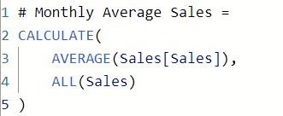
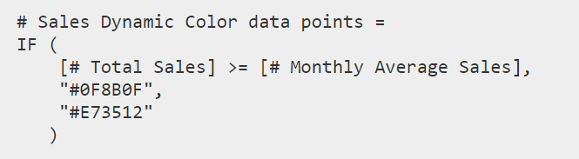
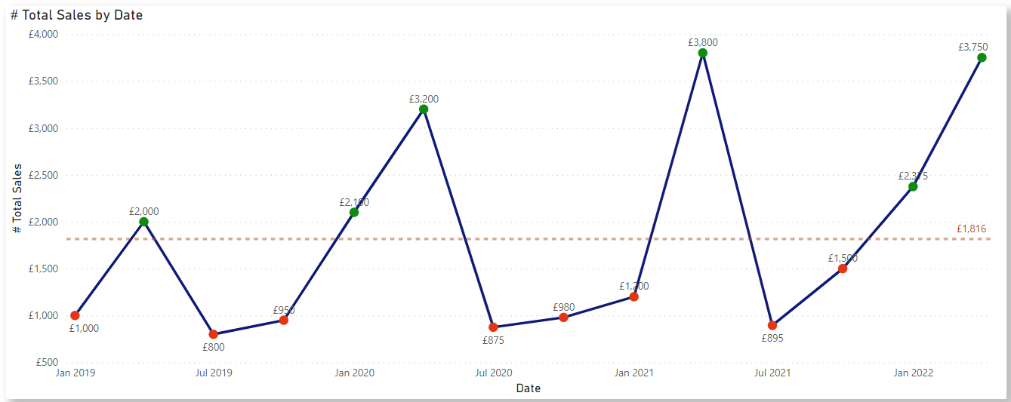
Use case 1: Dynamic Data points on Line chart Above & Below Average value
AVERAGE function returns the average of all numbers from Sales column
ALL calculates a calculation on all the rows of sales column ignoring any filters.
IF statement compares total sales with monthly average sales
A colour code is given based on conditional comparison
©datavibe

Slide 5
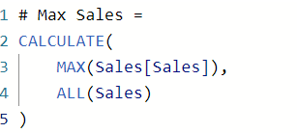
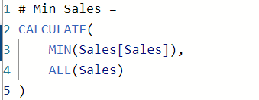
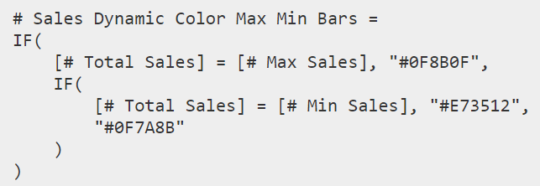
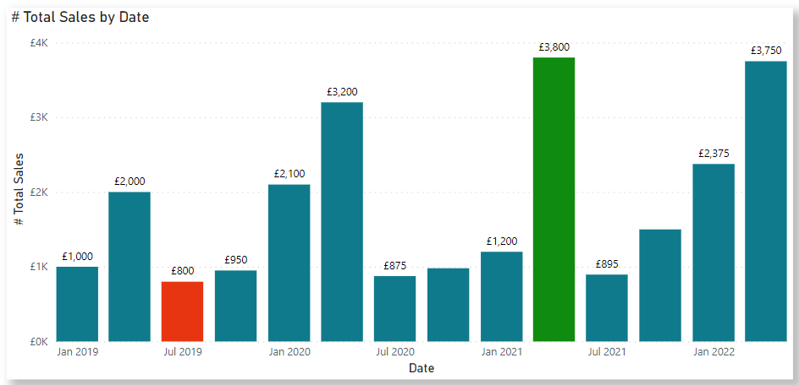
Use case 2: Highlight Max Min value on Bar Chart
Maximum sales value from Sales column.
ALL calculates a calculation on all the rows of sales column ignoring any filters.
Minimum sales value from Sales column.
ALL calculates a calculation on all the rows of sales column ignoring any filters.
A colour code is given based on conditional comparison
©datavibe

Slide 6
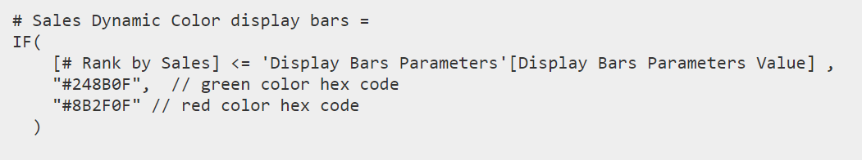
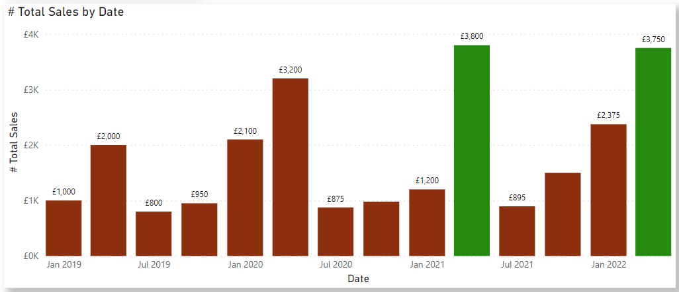
Use case 3: Display Top N Selected Bars in a Visual
RANKX returns a ranking based on sales value.
A colour code is given based on conditional comparison.
If my Rank value is <= value selected in the parameter, all the bars with rank <= get a GREEN colour.
©datavibe

Slide 7
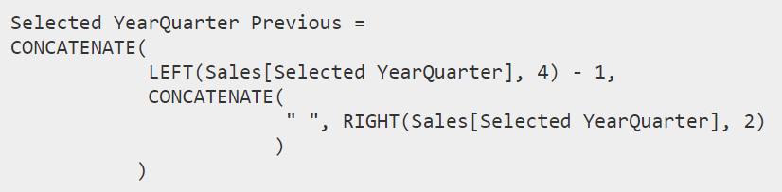
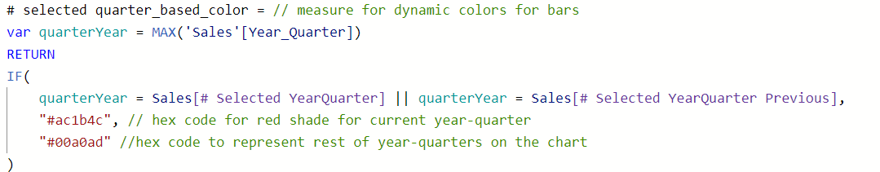
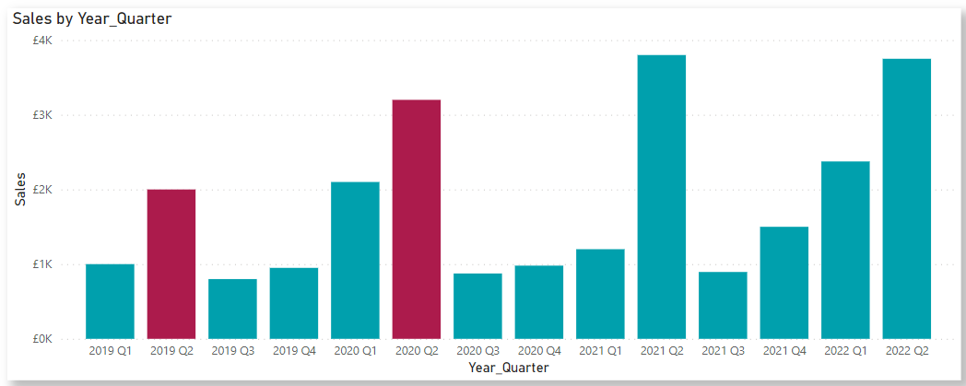
Use case 4: Dynamic Bar colours for Current & Previous Year SAME QUARTER
Getting selected value of Year-Quarter from slicer
LEFT extracts the number of characters from a string from left. In this case we extract the YEAR part from year-quarter column and subtract 1 to get previous year value. RIGHT extracts no. of characters from a string from right.
CONCATENATE further concatenates previous year and quarter value to a single string.
A colour code is given based on conditional comparison
©datavibe

Slide 8
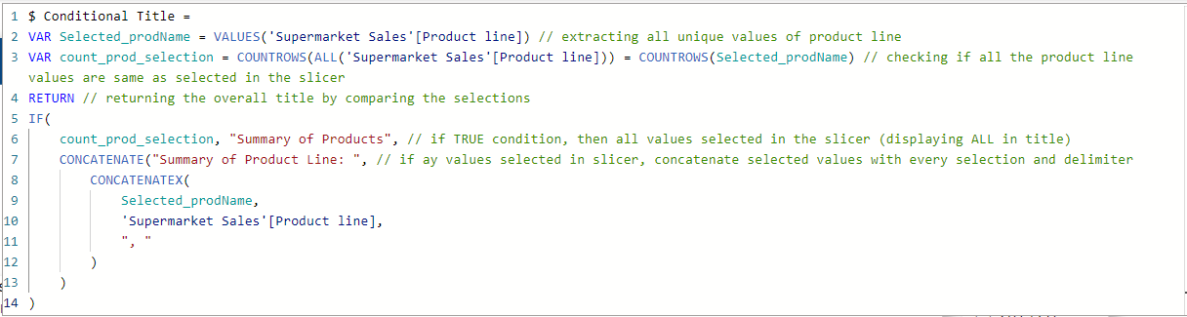
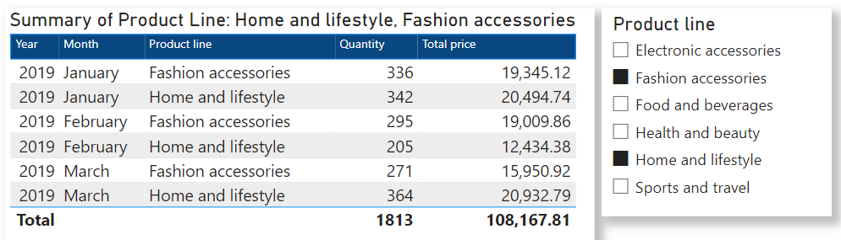
Use case 5: Conditional Titles on visuals based on User Selection
©datavibe

Slide 9
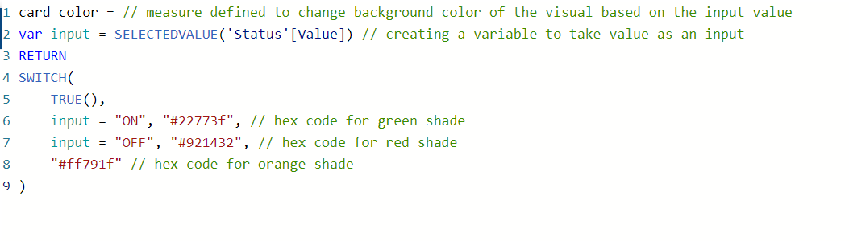
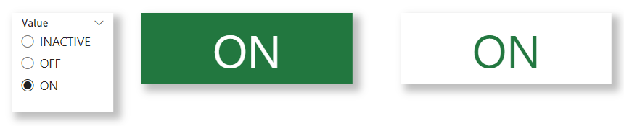
Use case 6: Dynamic colour to Card visual based on slicer selection
A colour code is given based on conditional comparison
©datavibe

Slide 10
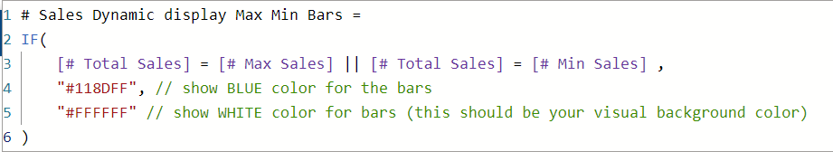
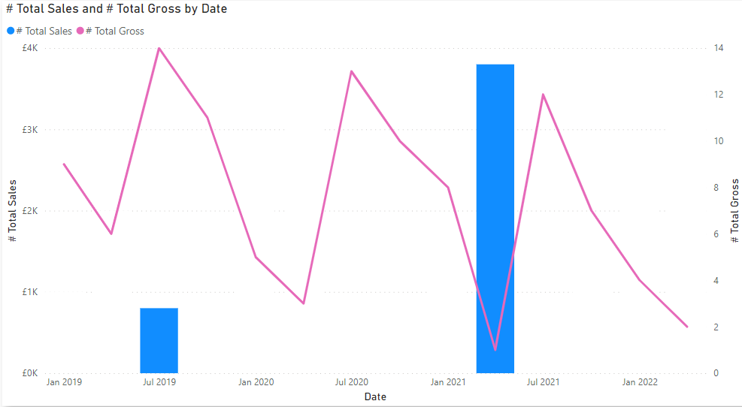
Use case 7: Display Max-Min bars on a combo chart with line for all points
©datavibe

Slide 11

Thank you and Happy to answer any questions!
©datavibe

